Slide 1
Keyword Utilized Research Paper Recommender
Data Structures and Applications Lab EL
Course Code: IS233AI
AJAY C | RVCE25BCI404
ISIRI | 1RV24CI042
MAYANK BAJAJ | 1RV24CI066
HARSHA KS | 1RV24CI038

Slide 2
INTRODUCTION
The project focuses on a research paper recommendation system that helps users find relevant academic papers efficiently.
As the number of publications grows rapidly, efficient data organization becomes essential for fast search and meaningful ranking.
This problem was selected to demonstrate how data structures improve search efficiency, scalability, and performance.
Similar systems are widely used in academic search engines, digital libraries, and research portals, making it highly relevant to real-world applications.

Slide 3
PROBLEM STATEMENT
Background of the Problem Domain
Rapid growth of research publications has made it difficult to find relevant and high-quality papers efficiently.
Simple keyword search often returns too many unranked results.
Existing System / Traditional Approach
Keyword-based search using titles or abstracts.
Manual filtering by users.
Limitations / Challenges in Existing Solutions
Ignores citation relationships between papers.
Treats all citations equally, without considering influence.
Inefficient for large datasets due to linear searching.
Poor ranking quality for research-oriented queries.

Slide 4
PROBLEM STATEMENT
Gap Identified
Lack of systems that combine fast keyword search with graph-based importance analysis.
Limited use of data structures to optimize search and ranking.
Final Problem Statement
This project develops a Keyword Utilized Research Paper Recommender that intelligently recommends relevant research papers to users based on their input keywords.The system employs core data structures (hashing, graphs, trees) and ranking algorithms to efficiently match papers, analyze citation networks, and recommend top papers ranked by citation relevance and topic alignment.

Slide 5
OBJECTIVES
To design and implement a recommendation system where users input keywords and receive relevant research papers using efficient data structure operations.
To utilize hash maps for fast keyword-to-paper lookup and metadata management, enabling O(1) average-case retrieval of papers by keyword.
To implement graph data structures (adjacency lists) to model citation networks between papers, enabling citation-based ranking and analysis.
To develop ranking algorithms that prioritize papers by citation count, relevance score, and topical match with user input keywords.
To provide a user-friendly interface where users enter keywords and receive top-ranked paper recommendations with citation network visualization.
To apply sorting and searching algorithms for efficient paper ranking and retrieval based on relevance metrics.

Slide 6
LITERATURE REVIEW
Sl. No. | Journal / Research Paper Details | Key Findings | Limitations | Technology Gap Motivating Proposed Solution
1. | Graph-based Approaches for Information Retrieval (2022) | Highlights how graph structures such as citation networks, co-occurrence graphs, and keyword–document graphs enhance information retrieval accuracy. Demonstrates graph metrics like in-degree and centrality for ranking. | Highly theoretical; does not provide simple or lightweight implementations suitable for small datasets. | Need for a compact citation graph model using adjacency lists and basic in-degree ranking tailored for small academic datasets (10–15 papers).
2. | Graph-based Document Representation and Retrieval: A Comprehensive Framework (2022) | Shows how representing documents as graph nodes with edges indicating relationships improves relevance and retrieval quality. Combines document metadata with structural graph analysis. | Framework is designed for large-scale data and requires complex processing pipelines. | Motivates a minimal, DSA-only graph representation where paper nodes and edges (citations) are processed using simple traversal and ranking algorithms.

Slide 7
LITERATURE REVIEW
Sl. No. | Journal / Research Paper Details | Key Findings | Limitations | Technology Gap Motivating Proposed Solution
3. | Efficient Trie-Based Techniques for Keyword Retrieval (2018) | Demonstrates Trie-based keyword indexing for fast prefix search and auto-completion, enabling efficient keyword discovery in text datasets. | Limited to keyword search; does not integrate document ranking or metadata-based retrieval. | Motivates using a Trie for fast keyword suggestion while combining it with graph-based ranking and hash-based matching to form a complete retrieval solution.
4. | Hash-Based Indexing Methods for Efficient Information Retrieval (2019) | Shows how hash-based indexing enables constant-time keyword-to-document lookup, improving retrieval speed and efficiency. | Does not address document relevance scoring; focuses primarily on indexing performance. | Motivates the use of a HashMap keyword→paper lookup table combined with ranking modules (citation graph + keyword scoring) for complete recommendation functionality.

Slide 8
PROPOSED SYSTEM - OVERVIEW
The proposed system aims to efficiently search and recommend relevant research papers using keywords and citation information.
It follows a structured pipeline that processes user queries, filters papers, computes relevance, and ranks results.
Data structures such as lists, hash maps, sets, and graphs form the backbone of the system, enabling fast lookup, indexing, and citation analysis.
Compared to traditional keyword-only approaches, the system improves search speed, ranking quality, and scalability with lower time complexity.

Slide 9
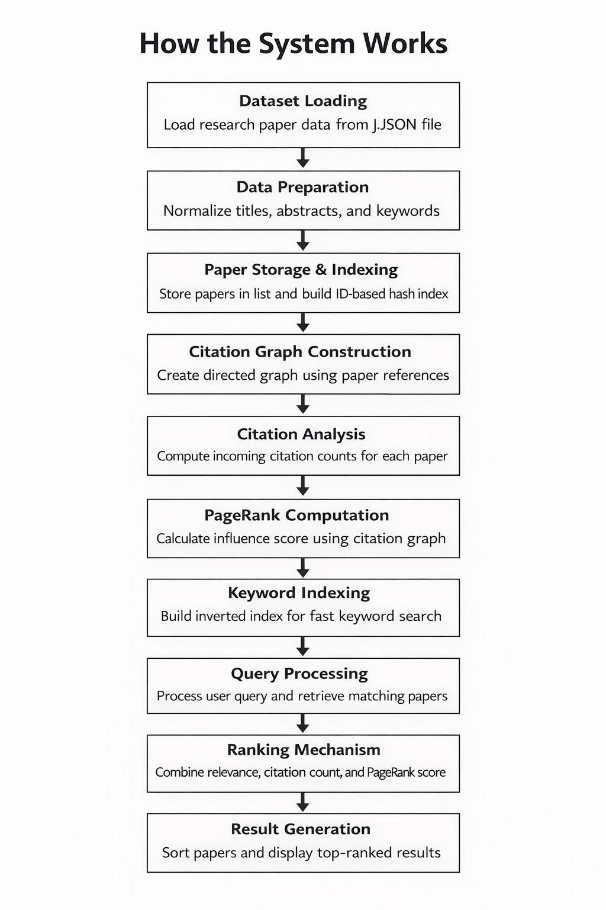
PROPOSED SYSTEM - OVERVIEW

Slide 10
FUNCTIONAL DESCRIPTION OF THE SYSTEM
Major Functionalities
Keyword-based research paper search
Citation count and influence analysis
Ranking and recommendation of papers
Input → Processing → Output
Input : User-entered keywords
Processing : Keyword filtering, citation analysis, relevance scoring, sorting
Output : Ranked list of relevant research papers

Slide 11
FUNCTIONAL DESCRIPTION OF THE SYSTEM
User Roles
Beginner: Simple keyword search
Researcher: Citation-aware ranked results
Core Data Operations
Insert and store paper metadata
Hash-based lookup by paper ID
Graph traversal for citation counting
Sorting based on relevance score

Slide 12
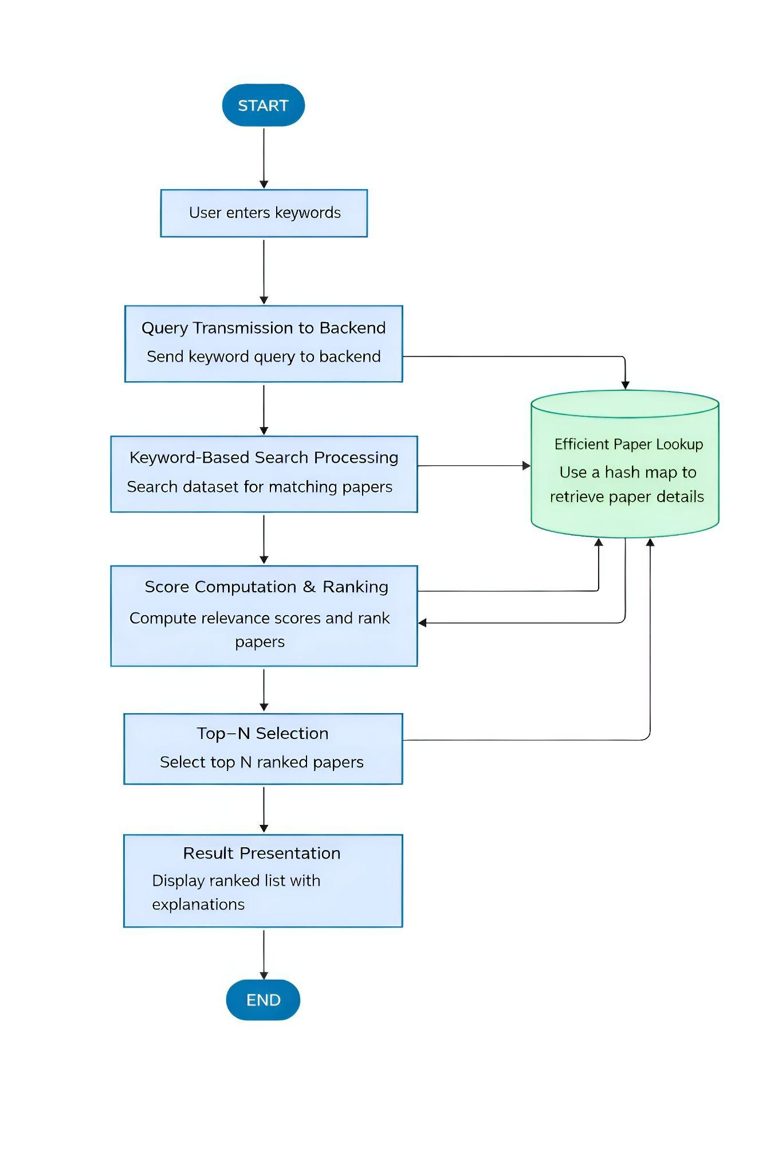
SYSTEM ARCHITECTURE

Slide 13
METHODOLOGY
Load papers into memory
Build search index (for fast lookup)
Build citation graph (for influence)
User enters a query
Relevant papers are retrieved
Papers are ranked
Top papers are recommended

Slide 14
METHODOLOGY
Data Loading and Storage
How data is stored
All papers are loaded once at startup.
Data is kept in memory for fast access.
Data Structures used
List → stores all papers
Dictionary (Hash Map) → maps paper_id → paper details
2. Building Search Index
Searching all paper line by line is time consuming therefore we use Inverted Index.
How Index Is Built?
1. Extract words from:
-Title
-Keyword
-Abstract
2. Normalize Text
3. Store Paper IDs under each word

Slide 15
METHODOLOGY
3. Candidate Paper Retrieval
Query is tokenized into words
Each word is looked up in the inverted index
All matching paper IDs are collected
Only relevant papers move to ranking stage
5. Citation Count(Popularity Measure)
Citation : Number of papers that cite a given paper
Citation count is calculated using the formula :
citation_count = number of incoming edges
Citation count measures the Popularity and it is used as minor ranking signal.
4. Citation Graph Construction
Node : Paper
Edges : Citation
Adjacency List : Outgoing Citations
Reverse Adjacency List : Incoming Citations

Slide 16
METHODOLOGY
6. PageRank Calculation (Influence Measure)
Core Idea : A paper is important if important papers cite it.
PageRank Calculation
Each paper starts with equal score.
Then repeatedly:
A paper distributes its score to papers it cites
Papers cited by important papers gain more score
This process repeats for multiple iterations
7. PageRank Formula
New Score =
base score + sum of (incoming paper score/ its outgoing citations)
Each paper gets a normalized influence score (0–1)
Higher score → more influential paper

Slide 17
METHODOLOGY
8. TF-IDF Relevance Scoring
Purpose : Measure how relevant a paper is to the query.
TF (Term Frequency)
Checks where the query word appears:
Title → high weight
Keywords → medium weight
Abstract → lower weight
IDF (Inverse Document Frequency)
Rare words get more importance
Common words get less importance
9. Final Score Calculation
Final Score = TF-IDF Score + PageRank Score + log(Citation Count)
10. Sorting and Recommendation Process
Final score calculated for each candidate paper
Papers are stored in a list
List is sorted in descending order

Slide 18
METHODOLOGY
Query Relevance (Using TF-IDF Logic)
What it measures: How well the paper matches your search keywords.
Calculation:
The system splits your query into words (tokens).
For each word, it checks:
Title Match: Worth 10 points.
Keyword Match: Worth 5 points.
Abstract Match: Worth 1 point.
It sums these points up.
Percentage Display:
The raw score is multiplied by 5 (capped at 100%).
Example: A score of 20 becomes 100%. A score of 4 becomes 20%.
Citation Influence (Using PageRank)
What it measures: The "authority" of the paper based on who cites it.
Calculation:
The system builds a Directed Graph of all papers.
It runs the PageRank algorithm (iterative calculation) to assign an "Influence Score" to every paper.
Papers are rewarded not just for number of citations, but for being cited by other important papers.
Percentage Display:
The raw PageRank value (which is usually a tiny decimal like 0.015) is multiplied by 5000 (to make it readable) and capped at 100%.
Reference Overlap
What it measures: How many other papers within your own dataset this paper references.
Calculation:
It counts the number of references in the paper's references list that exist in your papers.json file.
Percentage Display:
The count is multiplied by 10 (capped at 100%).
Example: References 3 internal papers = 30%. References 10+ papers = 100%.
Final Ranking Score
The papers are sorted by a weighted combination: Final Score = (Query Relevance * 1.5) + (Citation Influence * 2.0)

Slide 19
DATA STRUCTURES USED
Lists (Arrays)
Used to store the complete collection of research papers
Enable sequential traversal for keyword matching
Provide efficient iteration for ranking and analytics
Hash Maps (Dictionaries)
Used to map paper IDs to paper objects
Enable constant-time lookup of paper metadata
Used to store citation counts dynamically
Sets
Used to avoid duplicate references during citation analysis
Improve efficiency while computing reference overlaps
Graph Representation (Implicit)
References between papers form a directed graph
Nodes represent papers
Edges represent citation relationships

Slide 20
DATA STRUCTURES USED
Justification of Selected Data Structures
Lists are optimal for datasets that require frequent full scans
Hash maps ensure fast access to papers by ID, reducing lookup time
Sets prevent redundancy during reference and keyword analysis
Graph-based relationships enable citation-aware ranking
The time and space complexity of key operations are as follows:
Operation | Complexity
Keyword Search | O(n)
Citation Count Computation | O(n)
Paper Lookup ID | O(1)
Ranking and Sorting | O(n log n)

Slide 21
IMPLEMENTATION DETAILS
Programming language
Python 3.13.0 is used for implementing data structures and core logic.
Development environment / tools
Flask 3.1.2 for backend services
HTML, CSS, JavaScript for frontend
VS Code as the development environment
Modular structure of the implementation
Data loading and storage
Keyword indexing and search
Citation analysis and ranking
User request handling

Slide 22
TESTING AND VALIDATION
Testing Strategy Overview
1. Unit Testing
Data Structure Operations: Verify list insertion, hash map lookups, set operations
Keyword Indexing: Test inverted index creation and lookup
Citation Graph: Validate graph construction and adjacency list correctness
Ranking Functions: Test TF-IDF and PageRank calculations
2. Integration Testing
End-to-End Search Flow: User query → retrieval → ranking → recommendation
Data Pipeline: Load papers → build index → build graph → process query
Cross-module Interaction: Verify correct data passing between modules

Slide 23
TESTING AND VALIDATION
3. Performance Testing
Query Response Time: Measure search latency for various dataset sizes
Memory Usage: Monitor memory during data loading and processing
Scalability: Test with 10 papers
Sample Test Cases
Test Case 1: Basic Keyword Search
Expected Output:
Papers containing "machine learning" in title/keywords/abstract
Ranked by relevance score
Validation:
Correct papers retrieved
No false negatives
Sorted in descending order of score

Slide 24
TESTING AND VALIDATION
Test Case 2: Citation-Based Ranking
Input: Two papers with same relevance but different citation counts
Paper A: TF-IDF = 0.85, Citations = 15, PageRank = 0.72
Paper B: TF-IDF = 0.85, Citations = 5, PageRank = 0.45
Expected Output: Paper A ranked higher due to citation influence
Validation: Final Score A > Final Score B ✓
Test Case 3: Edge Case - Single Word Query
Input: Query = "learning“
Expected Output: All papers mentioning "learning" (broad retrieval)
Validation: High recall, papers ranked by IDF weight

Slide 25
TESTING AND VALIDATION
Sample Input and Output for researcher query with citations-
INPUT:
User Mode: Researcher , Query: “graph algorithms"]
PROCESSING:
Tokenize: ["graph", "algorithms"]
Retrieve: [P005, P009, P014]
Compute combined score:
TF-IDF: 0.85
PageRank: 0.68
Citation weight: log(12+1) = 1.11
Final = 0.85 + 0.68 + 1.11 = 2.64

Slide 26
TESTING AND VALIDATION
Sample Input and Output for beginner user query
INPUT:
User Mode: Beginner , Query: "data structures“
PROCESSING:
Tokenize: ["data", "structures"]
Lookup inverted index
Retrieve matching papers: [P003, P007, P012, P018]
Compute TF-IDF scores
Sort by relevance
OUTPUT:
Rank | Paper ID | Title | Score
1 | P003 | Data Structures and Algorithms | 0.92
2 | P007 | Advanced Data Structure Analysis | 0.88
3 | P012 | Hash Tables: Design and Implementation | 0.81
4 | P018 | Memory-Efficient Data Structures | 0.76

Slide 27
TESTING AND VALIDATION
OUTPUT:
Rank | Title | TF-IDF | PageRank | Citations | Final Score
1 | Graph Traversal Algorithms | 0.87 | 0.72 | 18 | 2.87
2 | Network Flow Optimization | 0.85 | 0.65 | 14 | 2.71
3 | Shortest Path Algorithms | 0.82 | 0.61 | 10 | 2.57

Slide 28
RESULTS AND ANALYSIS
Observed Results
Faster response time for keyword-based searches
Accurate retrieval of relevant research papers
Stable memory usage during execution
Meaningful ranking based on relevance and citation influence
Performance Comparison
Outperforms traditional linear keyword search in lookup speed
Provides better ranking quality than keyword-only systems
Lower computational overhead compared to ML-based approaches
More transparent and deterministic results

Slide 29
APPLICATIONS OF THE SYSTEM
Real-World Applications
Academic search engines and digital libraries
University research and project recommendation portals
Literature survey and scholarly analysis tools
Practical Relevance of Data Structures
Hash maps enable fast indexing and retrieval
Graphs model citation and relationship networks
Lists and sets support efficient traversal and duplicate control
Possible Domains of Use
Search and information retrieval systems
Database indexing and query optimization
Recommendation and knowledge discovery systems

Slide 30
CONCLUSION
The project successfully designed and implemented a research paper recommendation system using appropriate data structures.
Key learnings include efficient use of hash maps, lists, sets, and graphs to optimize search, retrieval, and ranking operations.
The proposed solution effectively improves search speed, ranking quality, and scalability compared to traditional approaches.
All stated objectives—efficient retrieval, citation-aware ranking, and modular design—were successfully achieved.

Slide 31
FUTURE SCOPE
Integrate a database-backed storage system to scale the solution for large research datasets.
Adopt advanced data structures such as optimized inverted indexes and graph-based ranking techniques for faster retrieval.
Enhance the system with semantic search and NLP techniques for better understanding of user queries.

Slide 32
REFERENCES
[1] Graph-Based Approaches for Information Retrieval. (2022). Journal of
Intelligent Information Systems. Springer. Available at:
[2] Graph-Based Document Representation and Retrieval: A Comprehensive
Framework. (2022). Engineering Applications of Artificial Intelligence. Elsevier.
Available at:
[3] Efficient Trie-Based Techniques for Keyword Retrieval. (2018). Proceedings of
the ACM.
[4] Hash-Based Indexing Methods for Efficient Information Retrieval. (2019). IEEE
Conference Proceedings.
[5] Information Retrieval and Ranking: A Survey of Current Techniques and
Future Directions. (2023). ACM Computing Surveys.
[6] Machine Learning for Information Retrieval: Applications in Academic Paper
Recommendation Systems. (2021). IEEE Transactions on Knowledge and Data
Engineering.
[7] Salton, G., Wong, A., & Yang, C. S. (1975). A vector space model for
automatic indexing. Communications of the ACM, 18(11), 613–620.

Slide 33
REFERENCES
[8] Robertson, S. E., & Zaragoza, H. (2009). The probabilistic relevance
framework: BM25 and beyond. Foundations and Trends in Information
Retrieval, 3(4), 333–389.
[9] Manning, C. D., Raghavan, P., & Sch¨utze, H. (2008). Introduction to
Information Retrieval. Cambridge University Press.
[10] Brin, S., & Page, L. (1998). The anatomy of a large-scale hypertextual web
search engine. Computer Networks and ISDN Systems, 30(1–7), 107–117.
[11] Page, L., Brin, S., Motwani, R., & Winograd, T. (1999). The PageRank
citation ranking: Bringing order to the web. Stanford InfoLab Technical Report.
[12] Haveliwala, T. H. (2002). Topic-sensitive PageRank. In Proceedings of the 11th
International World Wide Web Conference (WWW), 517–526.
[13] Kleinberg, J. M. (1999). Authoritative sources in a hyperlinked environment.
Journal of the ACM, 46(5), 604–632.
[14] Zhai, C., & Lafferty, J. (2001). A study of smoothing methods for language
models applied to information retrieval. ACM Transactions on Information
Systems, 22(2), 179–214.

Slide 34
REFERENCES
[15] Mikolov, T., Chen, K., Corrado, G., & Dean, J. (2013). Efficient estimation of
word representations in vector space. In Proceedings of the International
Conference on Learning Representations (ICLR).
[16] Deerwester, S., Dumais, S. T., Furnas, G. W., Landauer, T. K., & Harshman,
R. (1990). Indexing by latent semantic analysis. Journal of the American
Society for Information Science, 41(6), 391–407.
[17] Liu, T. Y. (2009). Learning to rank for information retrieval. Foundations and
Trends in Information Retrieval, 3(3), 225–331.
[18] Xu, J., & Croft, W. B. (1996). Query expansion using local and global
document analysis. In Proceedings of the 19th Annual International ACM
SIGIR Conference, 4–11.
[19] Zhou, D., Bousquet, O., Lal, T. N., Weston, J., & Sch¨olkopf, B. (2004).
Learning with local and global consistency. In Advances in Neural Information
Processing Systems (NeurIPS).
[20] Guo, Q., & Barbosa, D. (2018). Search result diversification based on topic
coverage. Information Retrieval Journal, 21(5), 429–452.

Slide 35
THANK YOU

